Slide 1



GSA Short Course Age-Depth Modeling of Sedimentary Deposits
Session 1
Radiocarbon dating and calibration
Intro to age-modeling

Slide 2
remember
Keep history etc. to minimum, don’t overload
Use animations
What info to provide beforehand?
Mail Amy when this is ready
Update GSA github page
Build in breaks to enable people to answer quick surveys (e.g. about speed/clarity)

Slide 3
Schedule
Today: radiocarbon, intro to age-modelling
Next week: Bayesian age-models
Final session: Running your own cores, ²¹⁰Plum

Slide 4
Today
Radiocarbon dating
Radiocarbon calibration
Intro to age-modelling
Mixing Powerpoint slides with R code
Keep R open, try to run the blue R code on your own computer
Speak up (chat) when things go wrong!

Slide 5
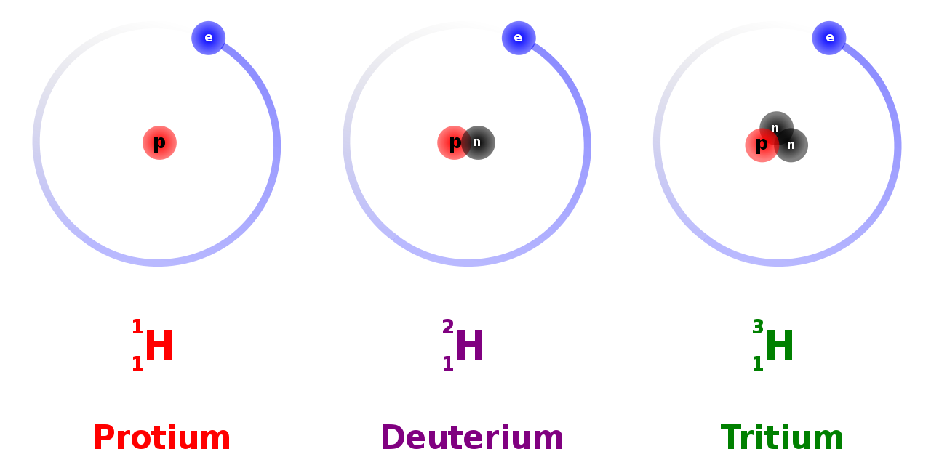
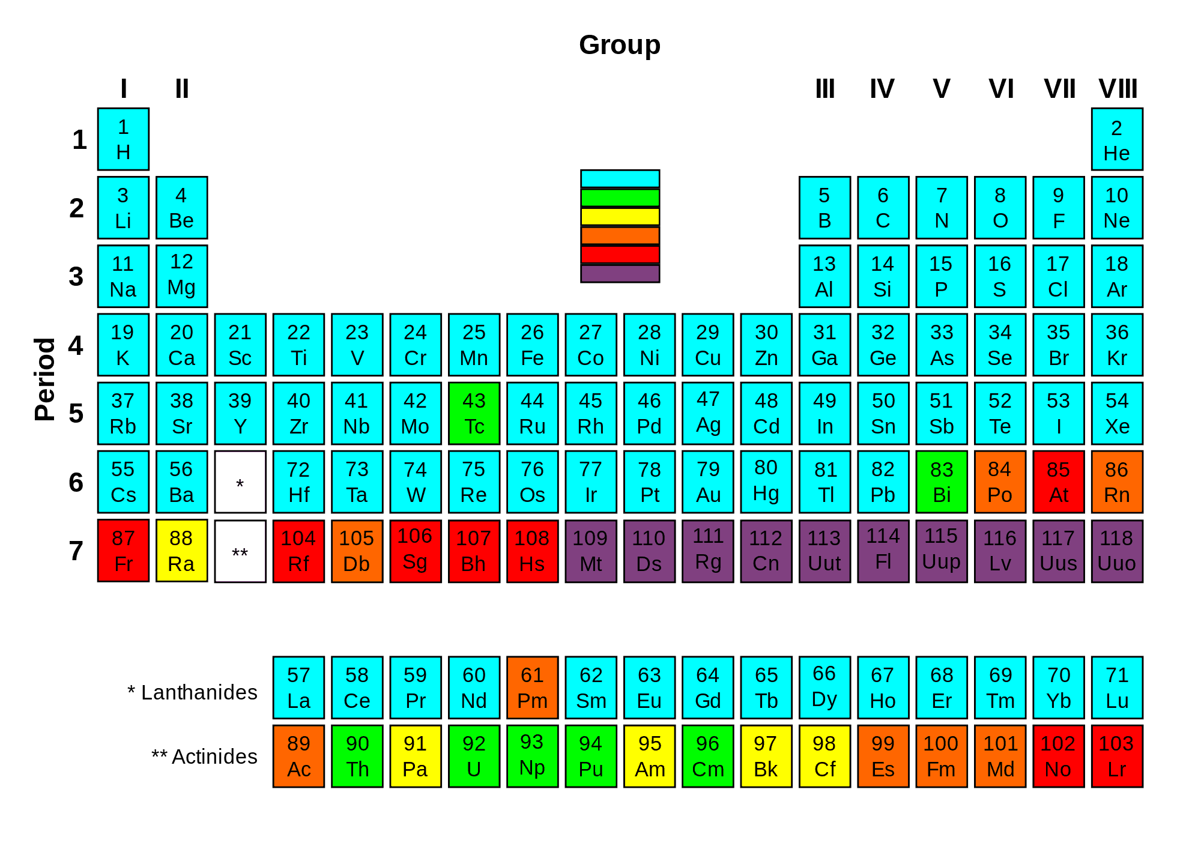
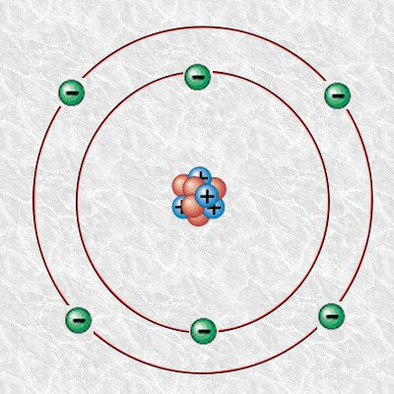
https://www.nuclear-power.com/nuclear-power/reactor-physics/atomic-nuclear-physics/nuclear-stability/

Slide 6
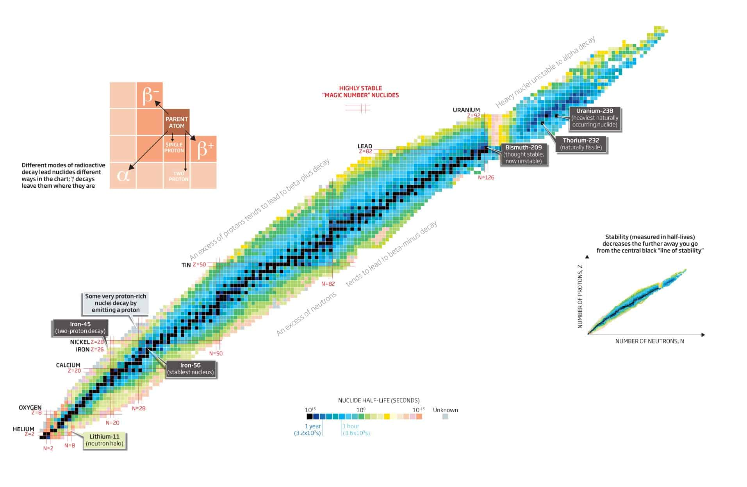
https://www.nuclear-power.com/nuclear-power/reactor-physics/atomic-nuclear-physics/nuclear-stability/

Slide 7
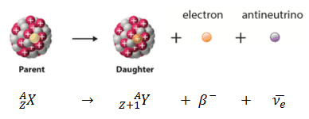
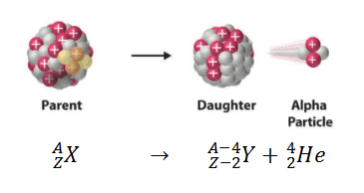
https://geoinfo.nmt.edu/resources/uranium/what.html

Slide 8
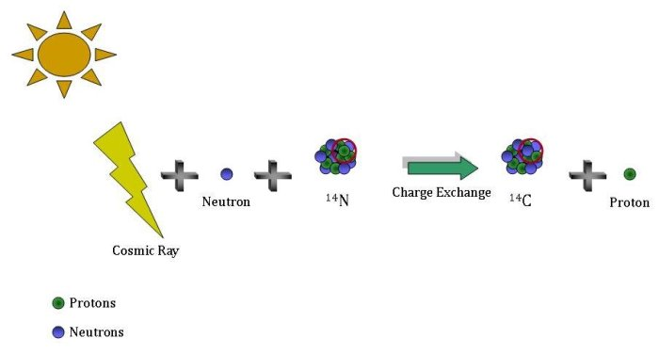
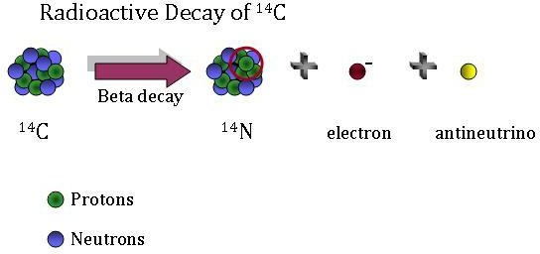
https://gml.noaa.gov/ccgg/isotopes/decay.html

Slide 9
Radioactive decay
Decay rates are constant as far as we know
Not influenced by environment
Average lifespan ¹⁴C 8600 years – half-life 5730
100% at t=0 (AD 1950)

Slide 10
Radioactive decay
List ten half-lives:
yr <- seq(0, by=5730, length=10)
halflives <- .5 ^ (0:9)
cbind(yr, 100*halflives)

Slide 11
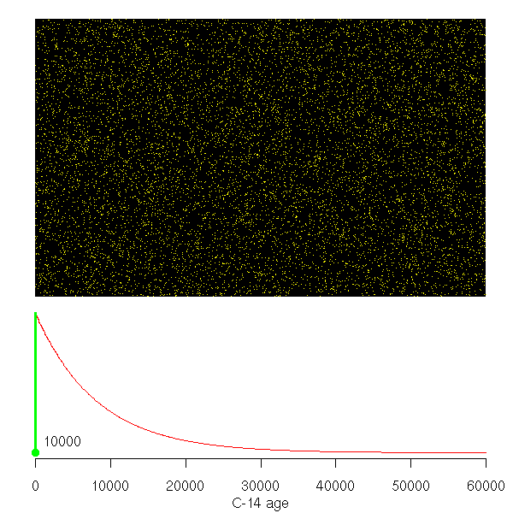
https://maarten14c.github.io/

Slide 12
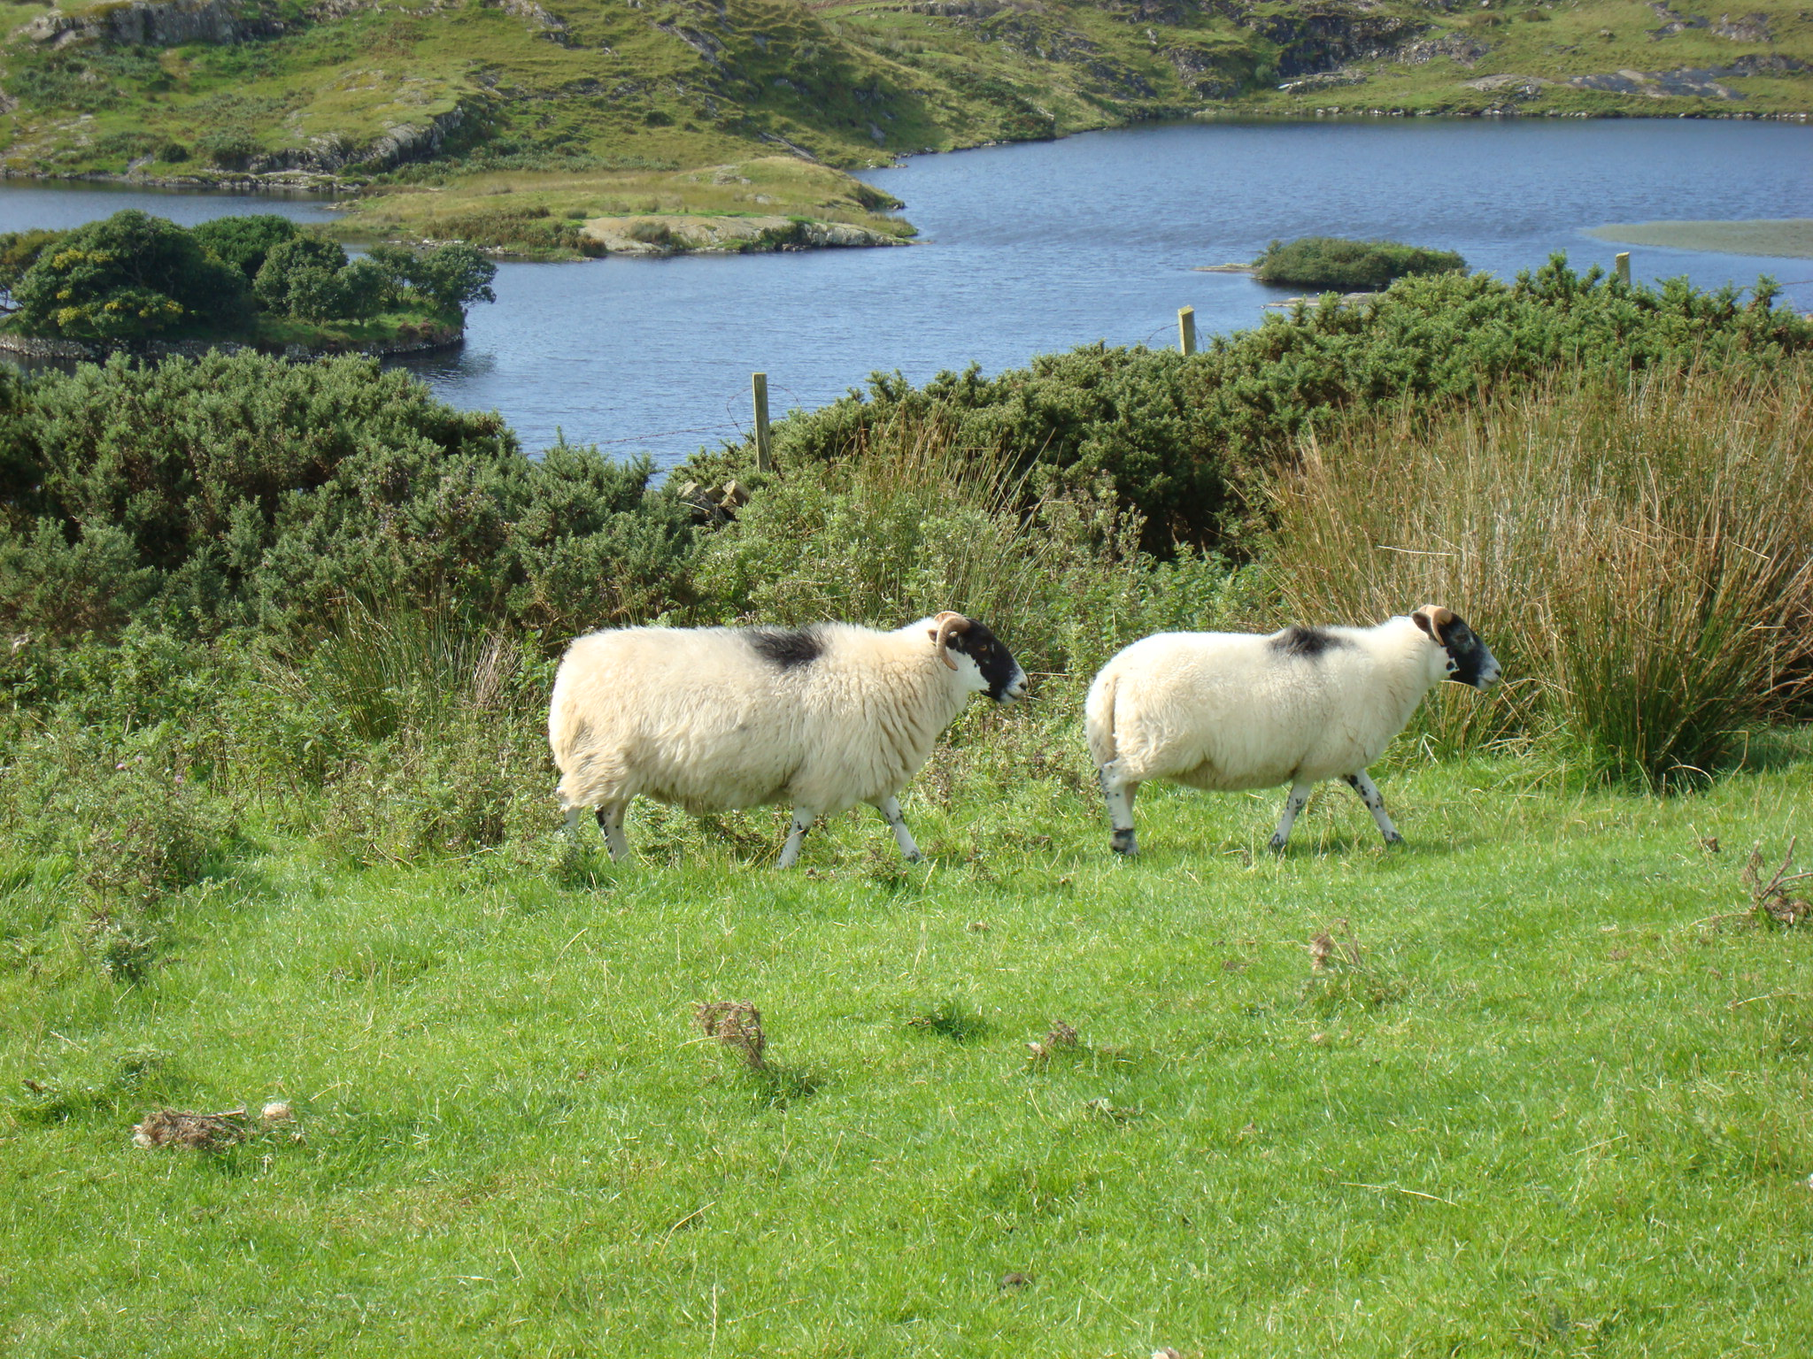
Cosmic rays
¹⁴N + n
¹⁴C + O₂
¹⁴C + p
¹²CO₂
¹⁴CO₂
¹³CO₂
¹⁴C/¹²C
Notes:
14C production
Exchange with reservoirs

Slide 13
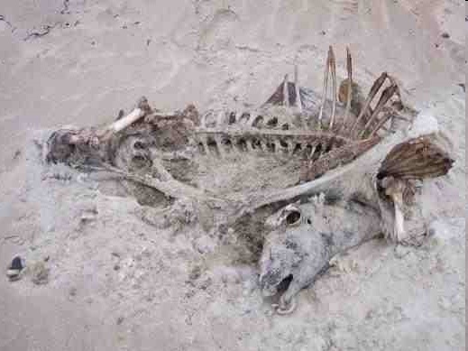
Cosmic rays
¹⁴N + n
¹⁴C + O₂
¹⁴C + p
¹²CO₂
¹⁴CO₂
¹³CO₂
¹⁴C/¹²C
Notes:
14C production
Exchange with reservoirs

Slide 14
Libby’s ¹⁴C decay counter

Slide 15
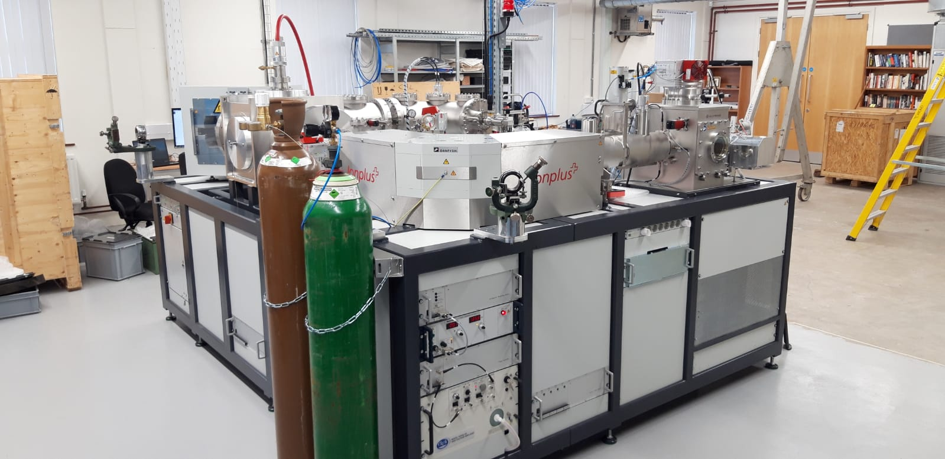
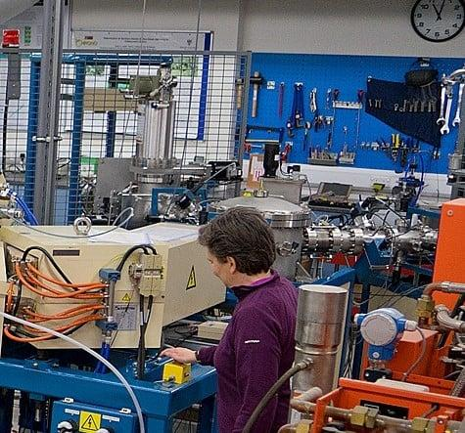
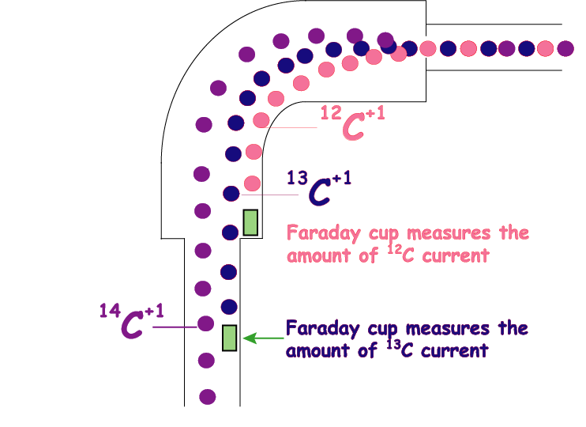

Slide 16
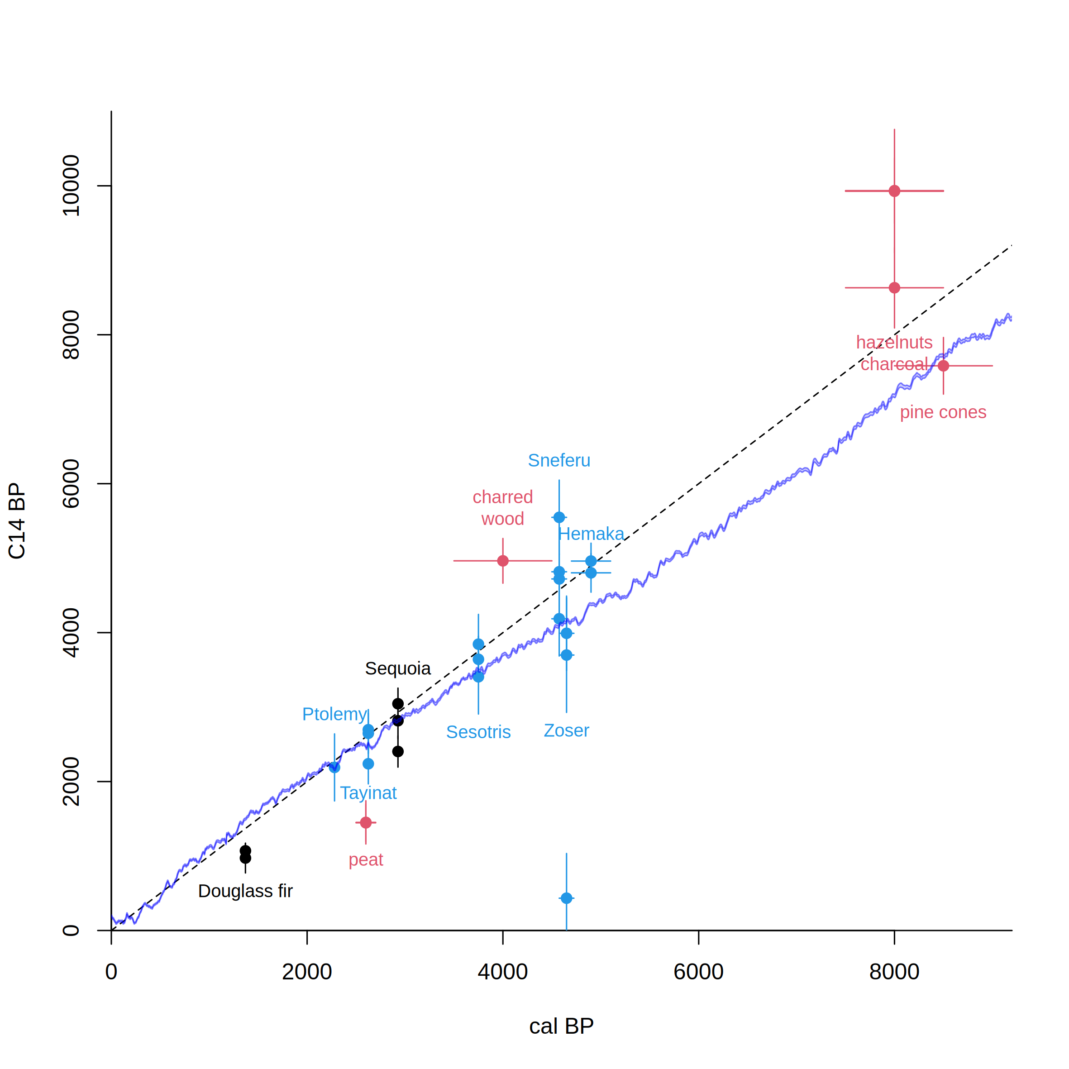
Libby’s Curve of Knowns vs IntCal20
After Arnold & Libby 1951
Science 113, 111-150
Notes:
45
sample of acacia wood from the tomb of the pharaoh Zoser (or Djoser; 3rd Dynasty, ca. 2700-2600 BC) was obtained and dated. Libby reasoned that since the half-life of C14 was 5568 years, they should obtain a C14 concentration of about 50% that which was found in living wood (see Libby, 1949 for further details). The results they obtained indicated this was the case.

Slide 17
Radiocarbon calibration
CALIBRATION: verification that the method is accurate
Chunks of wood representing 10-20 years were taken from tree-ring dated US trees, and the ¹⁴C in them was measured
The exact age of each tree ring was known
This gave a continuous record of atmospheric ¹⁴C
Confirmed in European labs

Slide 18
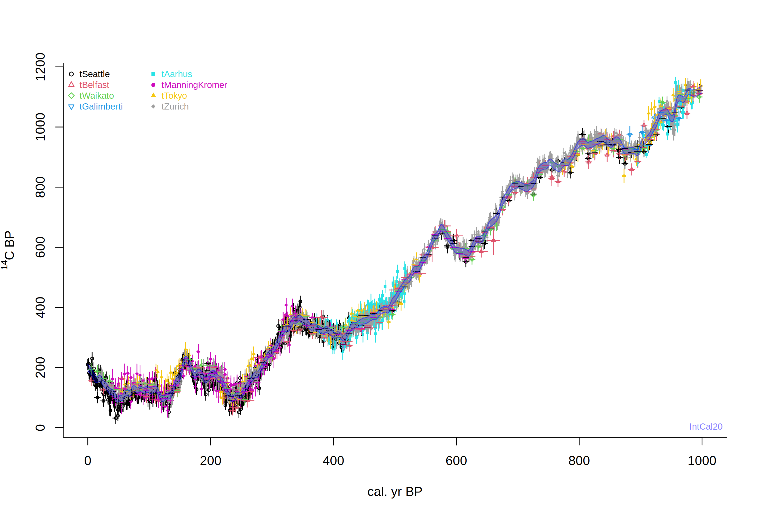
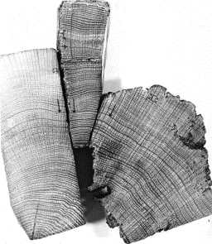
IntCal20. Levels of ¹⁴C fall over time, but because the formation rate varies, the shape of calibration curve is jagged.
Years before present, where Present = AD 1950

Slide 19
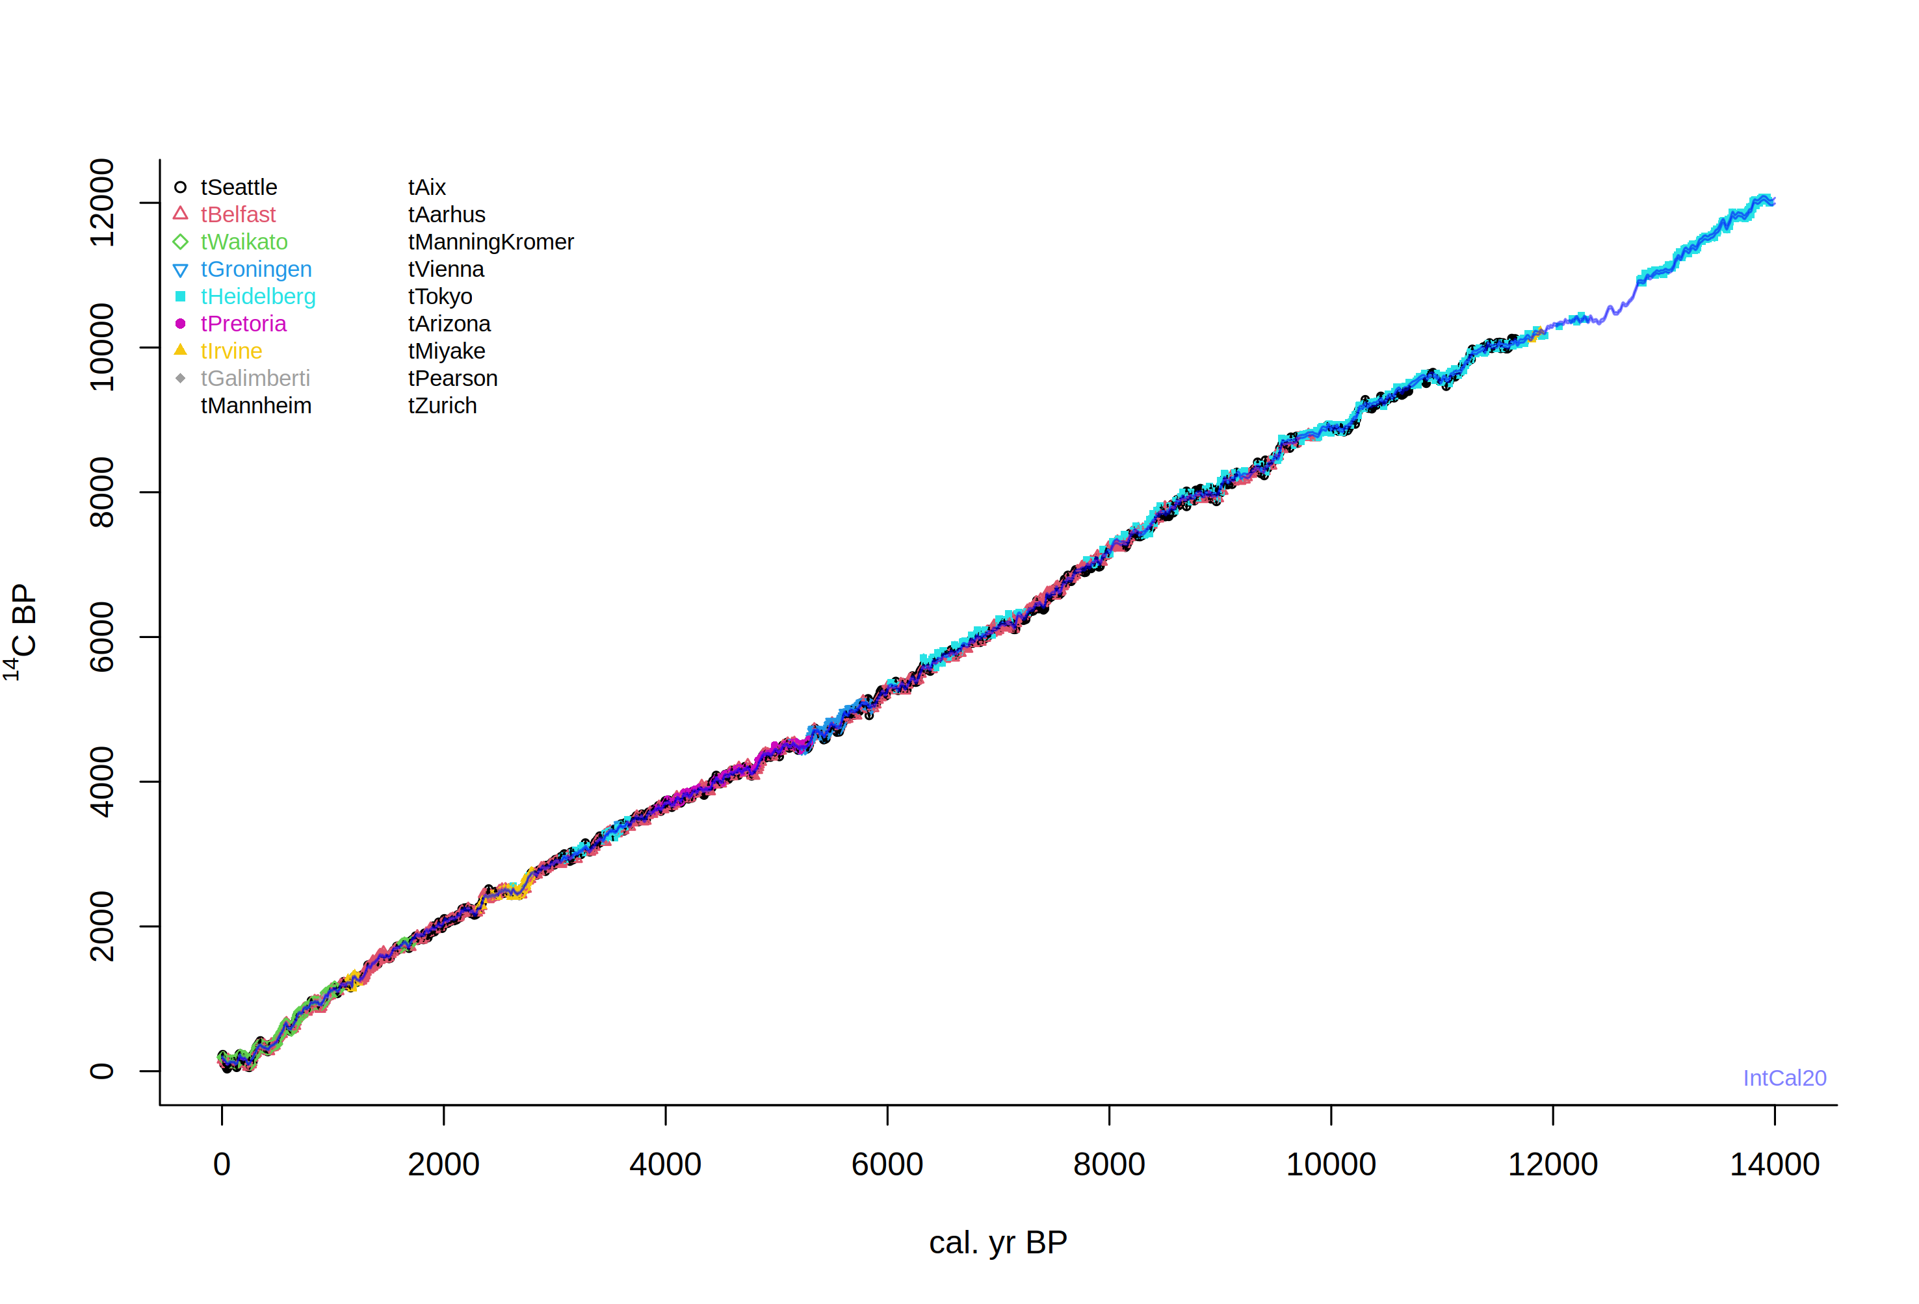

Slide 20
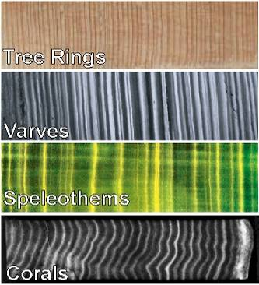
Extension of the ¹⁴C calibration curve
More tree rings
Varves (marine or lacustrine)
Speleothems
Corals

Slide 21
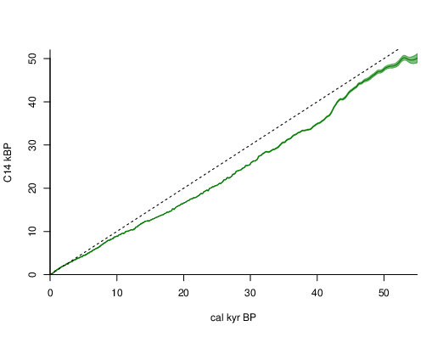
IntCal20
Reimer et al. 2020

Slide 22
Assumptions ¹⁴C
Constant atmospheric ¹⁴C levels
Well-mixed carbon reservoirs
The target event is dated

Slide 23
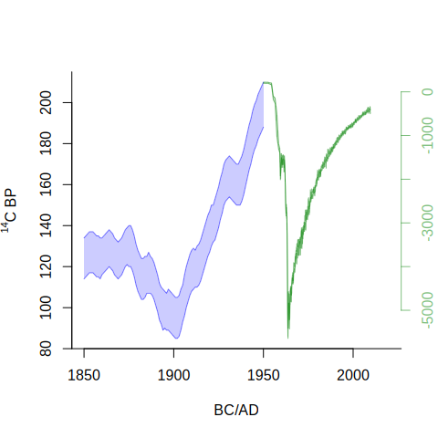
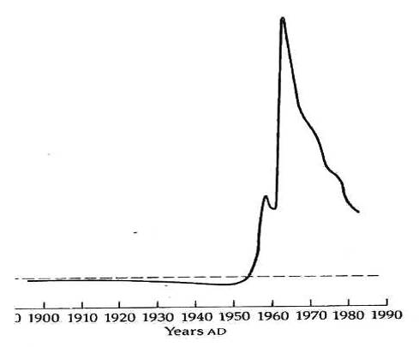
Factors influencing amount of ¹⁴C in the atmosphere
anthropogenic activity (burning of fossil fuels, bomb tests): release of ‘old’ or ‘new’ carbon
Bowman S., 1990
Notes:
45
de Vries found that 17-th century wood had a 2% higher activity than 19th century wood.

Slide 24
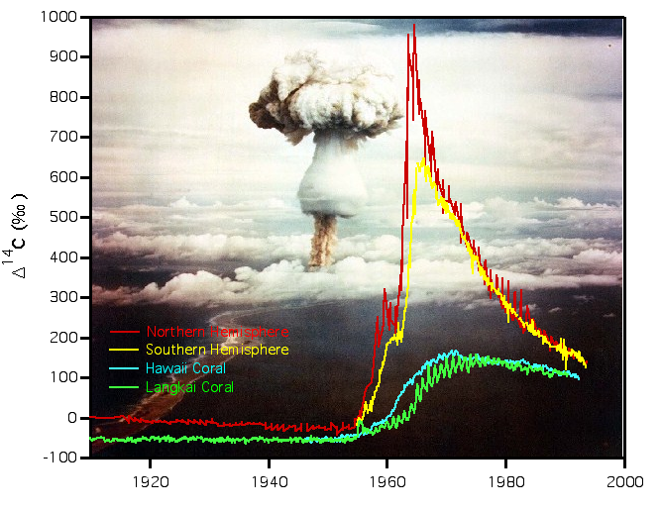
Atmospheric nuclear testing ¹⁴C
Courtesy Stewart Fallon, LLNL
Notes:
45

Slide 26
require(IntCal)
intcal.data(0, 1000)
intcal.data(30e3, 40e3)
draw.ccurve()
draw.ccurve(1850, 2020, BCAD=T, cc2="nh1", add.yaxis=T)

Slide 27
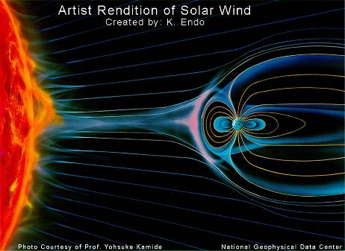
Factors influencing amount of ¹⁴C in the atmosphere
anthropogenic activity (burning of fossil fuels, bomb tests): release of ‘old’ or ‘new’ carbon
variations in solar activity
variations in the Earth’s magnetic field
changes in carbon cycle
http://www.ngdc.noaa.gov/seg/geomag/icons/solarexp.jpg
Notes:
45

Slide 28
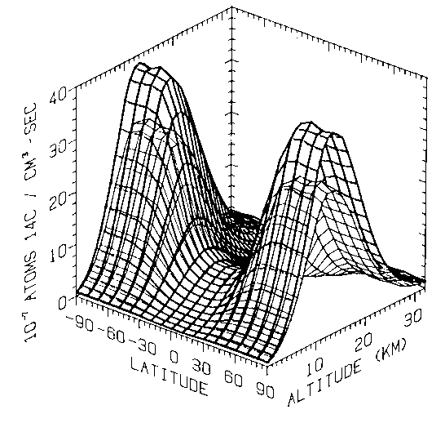
¹⁴C production
Sunspot minimum
Sunspot maximum
Braziunas et al., 1995, based on Lingenfelter 1963

Slide 29
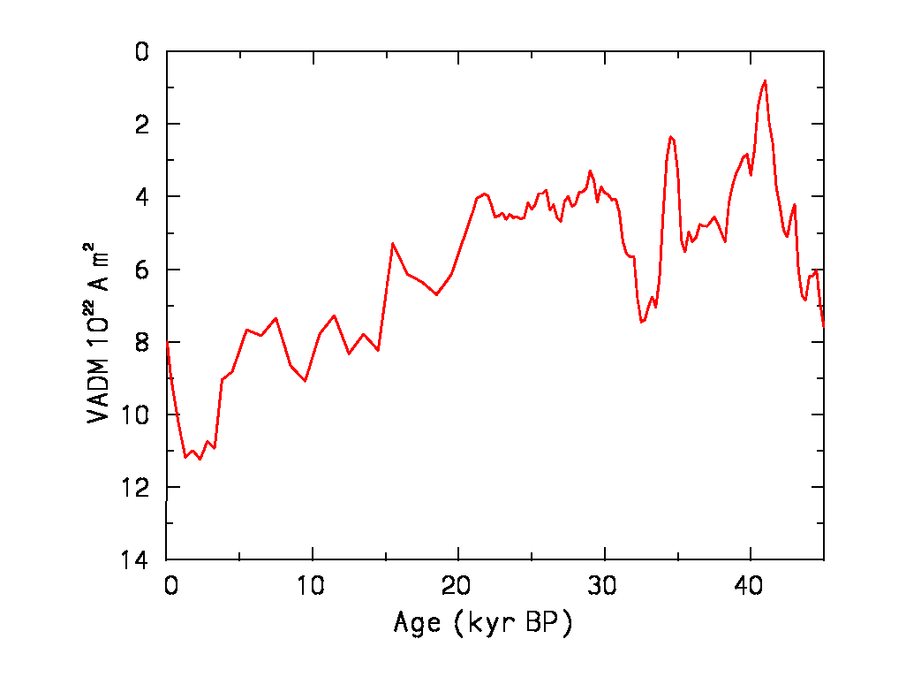
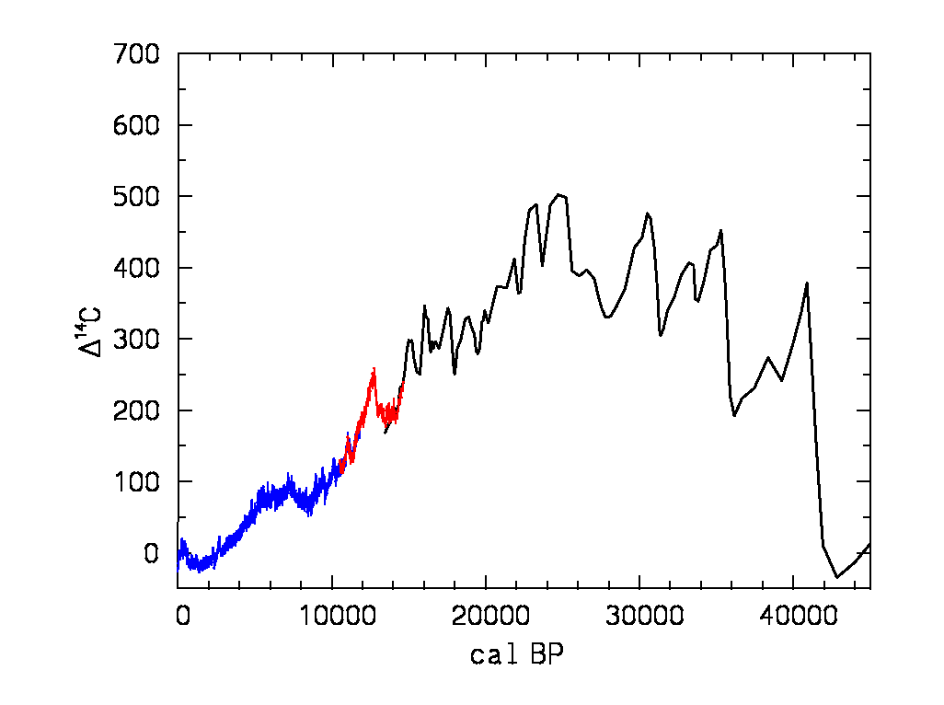
¹⁴C vs. geomagnetic strength
Dipole moment
¹⁴C
?

Slide 30
Assumptions ¹⁴C
Constant atmospheric ¹⁴C levels
Well-mixed carbon reservoirs
The target event is dated

Slide 31
Estimated Carbon Reservoir Sizes and Ages
Atmosphere 750 Gt
0
Plants 550 Gt
1 – 250 yrs
Soils & peat 2000 Gt
1 – 10,000 yrs
Millions of yrs
¹⁴C free
Fossil fuels 5000 Gt
Surface ocean 1000 Gt
400 – 1000 yrs
Deep ocean 38,000 Gt
1000 – 2000 yrs
1 Gigaton (Gt) = 10¹⁵ tons
IPCC 1990

Slide 32
Marine reservoir effect
Difference in radiocarbon age of surface water and atmosphere due to slow exchange
Average c. 500 years
+ Local upwelling of old water
0 to + 900 years
Example: Scott polar expedition (AD 1912)
Apparent age penguin 1390 ± 40 BP seal 1300 ± 50 BP

Slide 33
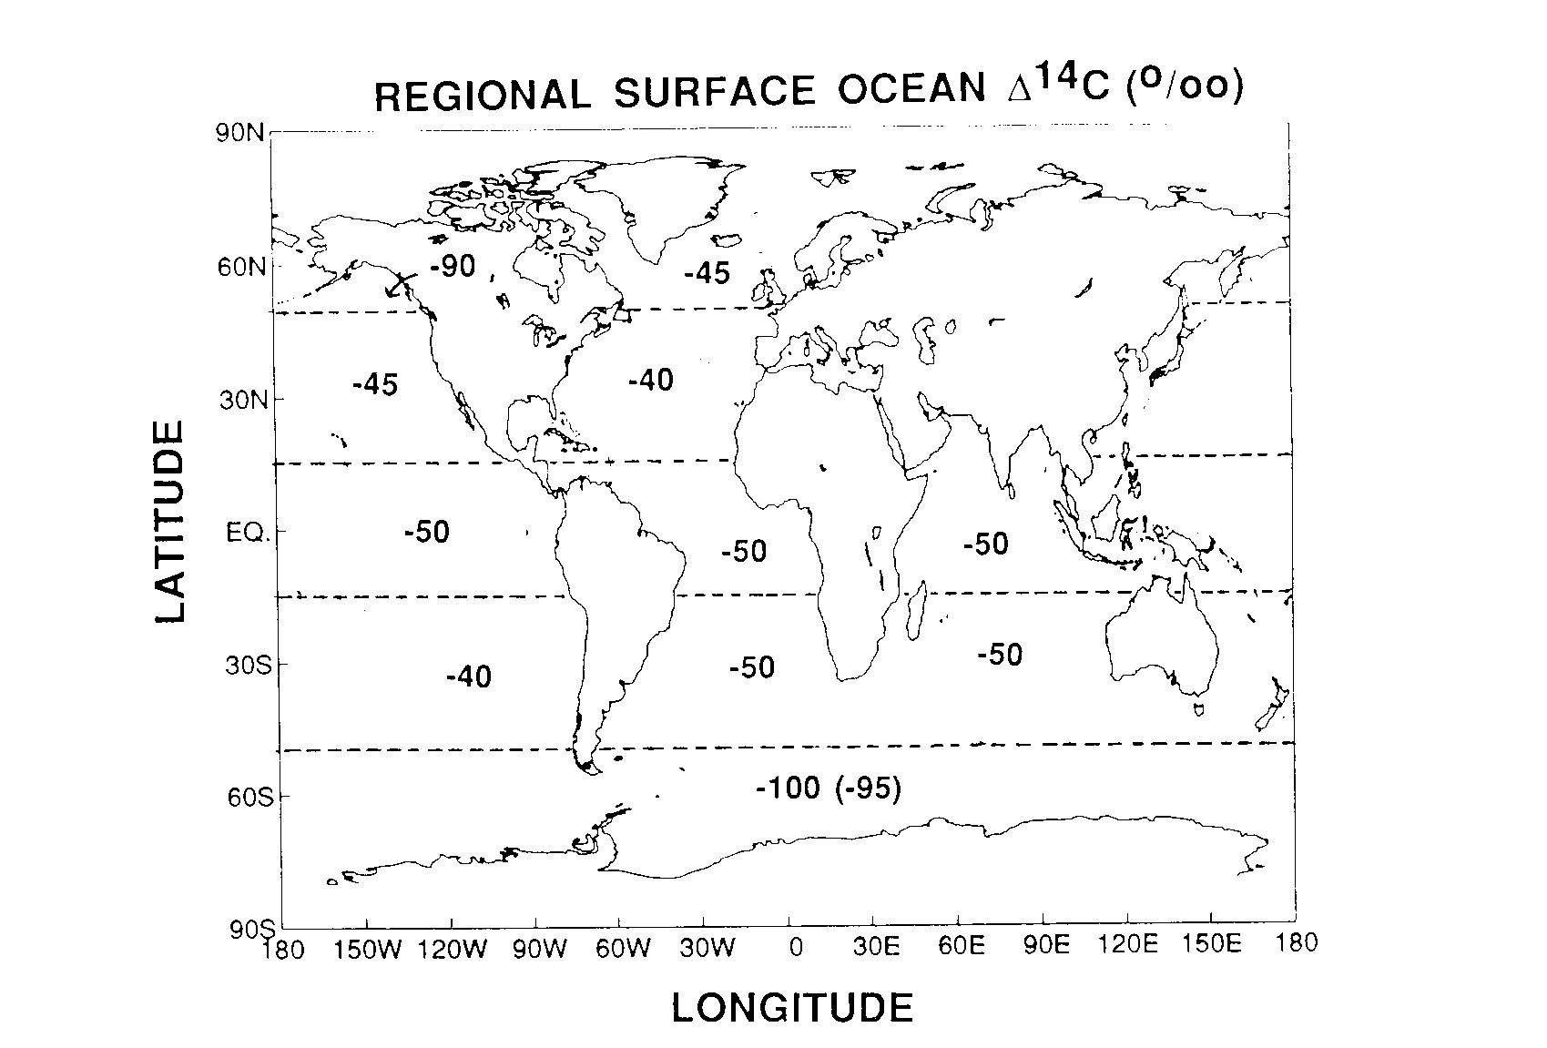

Slide 34
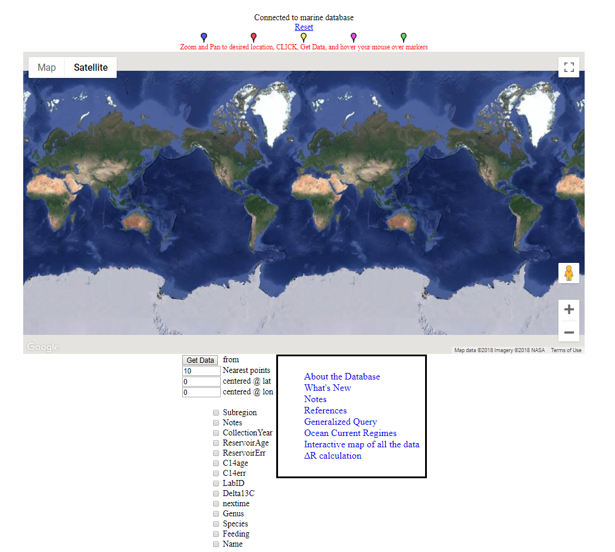
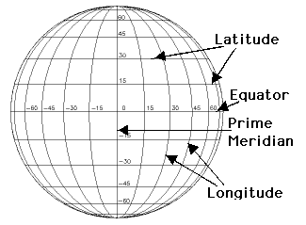
Marine Reservoir Correction Database
http://calib.org/marine/

Slide 35
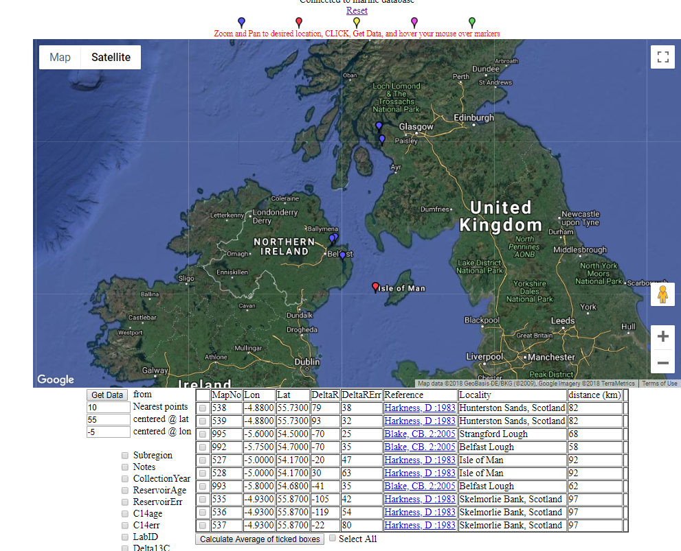
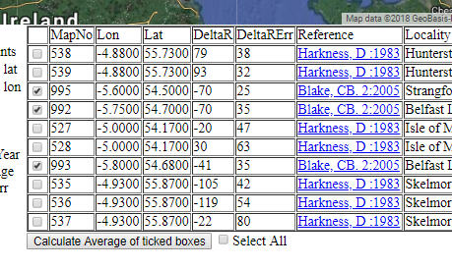
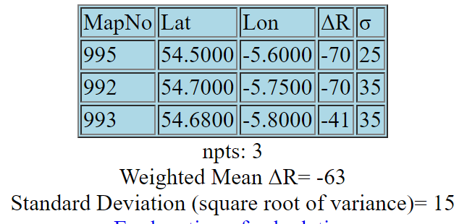

Slide 36
Assumptions ¹⁴C
Constant atmospheric ¹⁴C levels
Well-mixed carbon reservoirs
The target event is dated

Slide 37
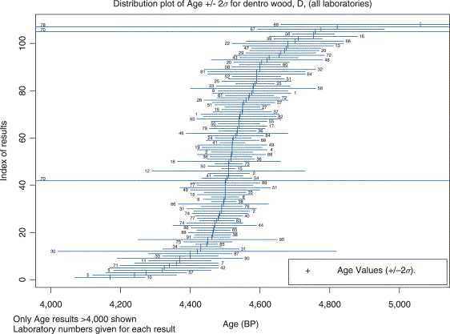
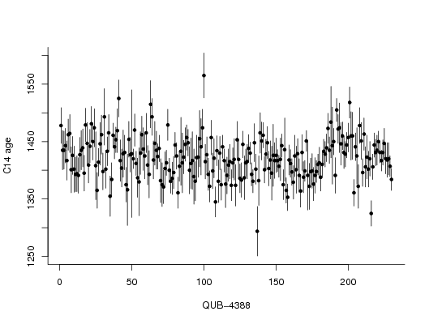
Scott, 2013 (Encycl. Quat. Sci.)
Notes:
45

Slide 38
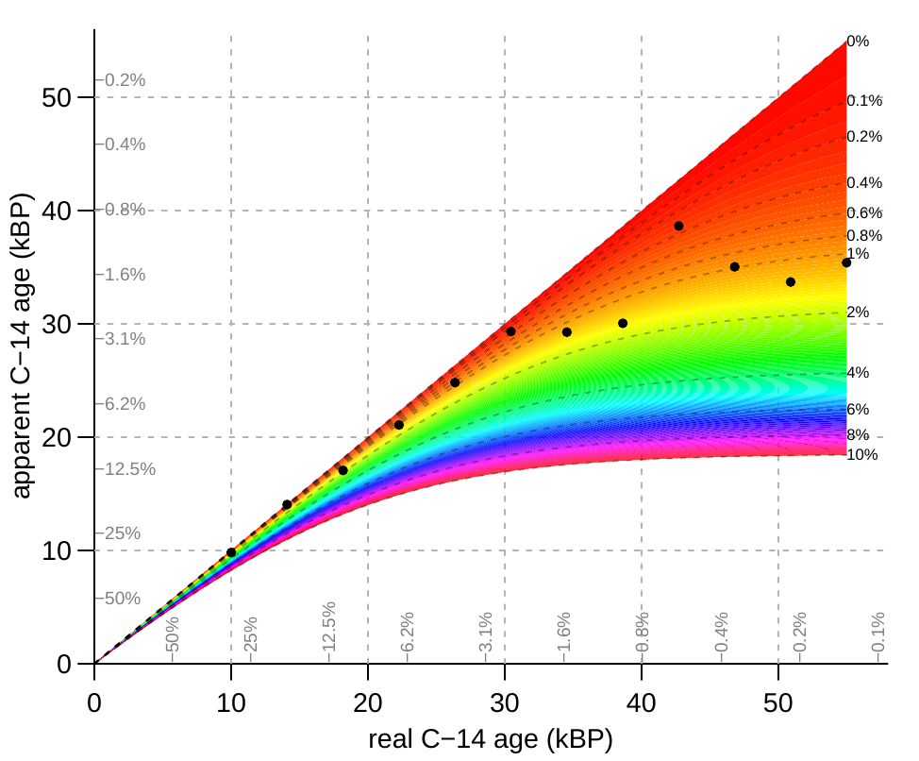

Slide 39
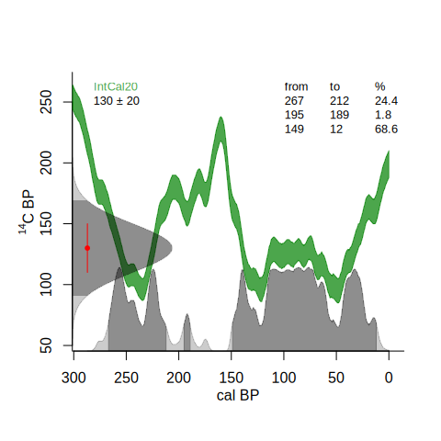
¹⁴C calibration
calibrate()
Notes:
45

Slide 40
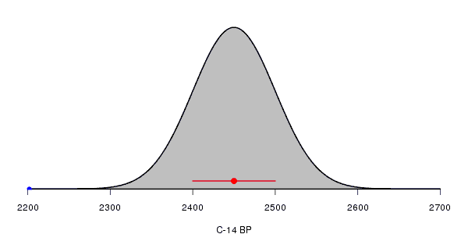
¹⁴C calibration
Each radiocarbon date comes with a lab error
Assumed to be distributed normally/Gaussian
Or alternatively, a student-t distribution with longer tails
Notes:
45

Slide 41
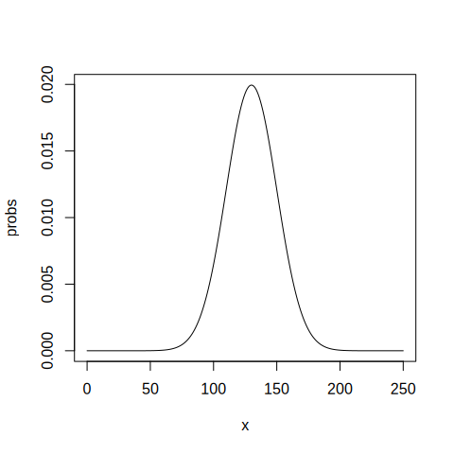
¹⁴C calibration
dnorm(125, 130, 20)
dnorm(130, 130, 20)
x <- 0:250
probs <- dnorm(x, 130, 20)
head(cbind(x, probs))
sum(probs)
plot(x, probs, type="l")
Notes:
45

Slide 43
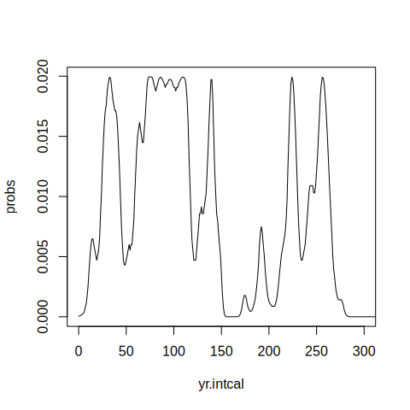
¹⁴C calibration
cc <- ccurve()
yr.intcal <- cc[,1]
c14.intcal <- cc[,2]
probs <- dnorm(c14.intcal, 130, 20)
plot(yr.intcal, probs, xlim=c(0, 300), type="l")
Notes:
45

Slide 44
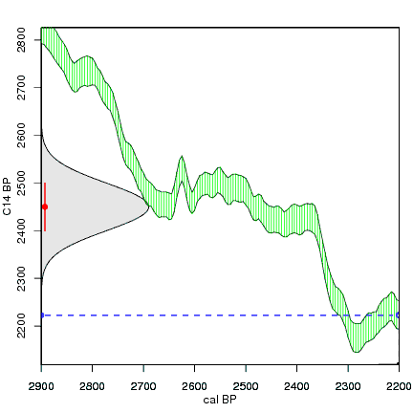
¹⁴C calibration
calibrate()
cc <- ccurve()
head(cc)
maarten14c.github.io
Notes:
45

Slide 45
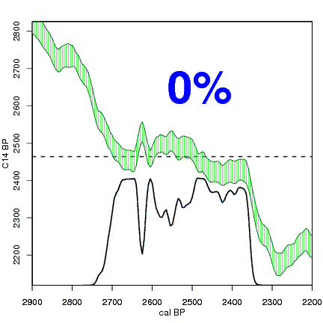
¹⁴C calibration – hpd ranges
Notes:
<number>

Slide 46
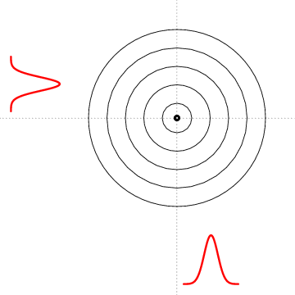
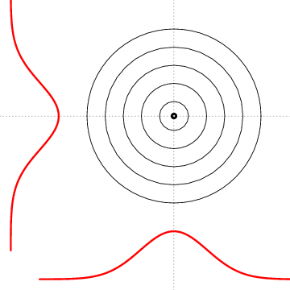
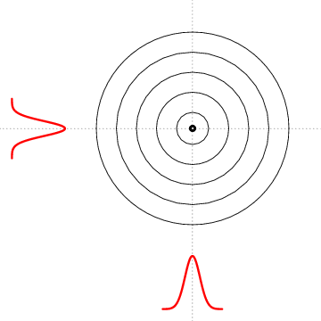
Notes:
<number>

Slide 47
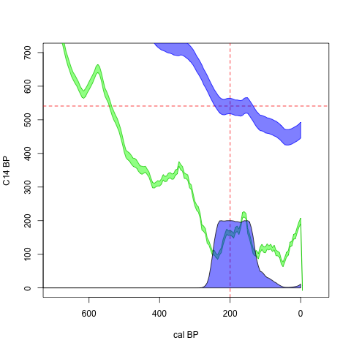
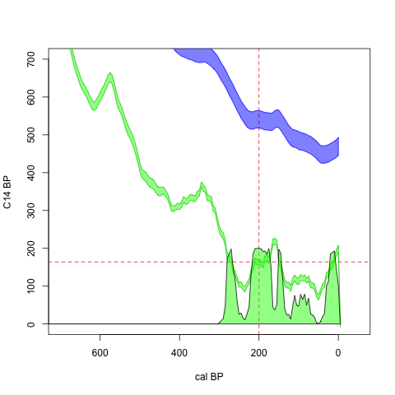

Slide 49
